Slide 1
Welcome!
Sunday
Worship 10:00 AM
Sunday
Bible Class (Livestream) 5:00 PM
Wednesday
Bible Class 7:00 PM
www.SunsetchurchofChrist.net

Slide 2
Opening Prayer
Song – | Craig Foster
Song – | Craig Foster
Lord’s Supper
Song – | Craig Foster
Song – | Craig Foster
Lesson | Brian Haines
Song – | Craig Foster
Closing
1 Corinthians 16:2
On the first day of the week let each one of you lay something aside, storing up as he may prosper, that there be no collections when I come.
A collection basket
is in the foyer

Slide 3
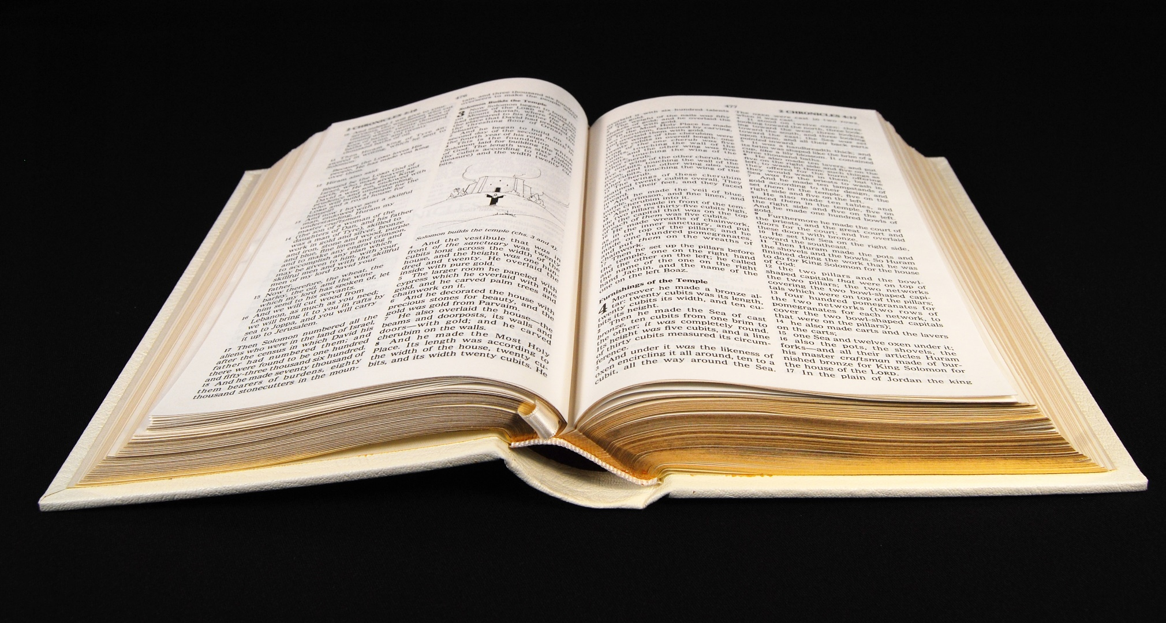
Can We Understand Alike?

Slide 4
Notes:
Truth is subjective

Slide 5
Post-Modernism: No Absolute Truth
Notes:
Truth is subjective

Slide 6
Notes:
Objective Truth requires an authority of origin

Slide 7
Notes:
Objective Truth requires an authority of origin

Slide 8
Understanding Things Alike
Knowing this first, that no prophecy of Scripture is of any private interpretation, for prophecy never came by the will of man, but holy men of God spoke as they were moved by the Holy Spirit 2 Peter 1:20-21

Slide 9
Understanding Things Alike
Principles to unity in Biblical understanding:
1) We did not write this, God did
2) We cannot understand it personally
How do we approach the Scriptures?

Slide 10
Authority

Slide 11
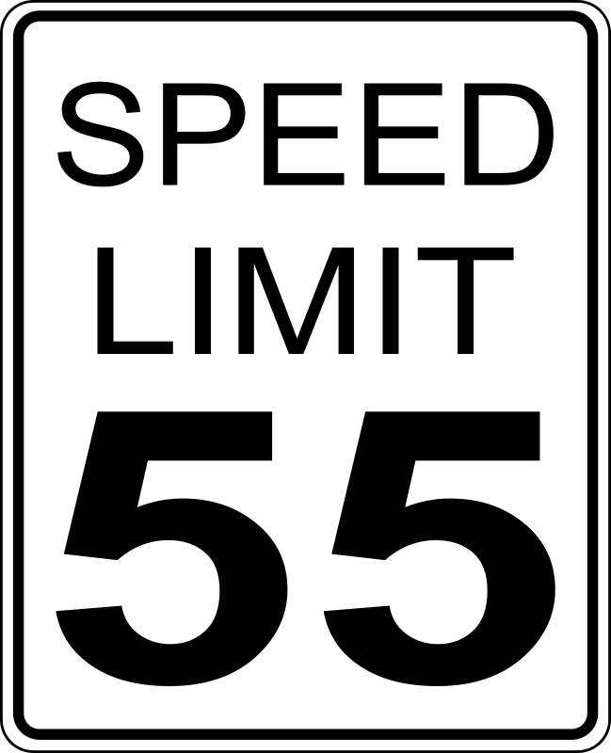
Authority

Slide 12
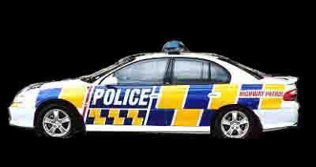
Authority

Slide 13
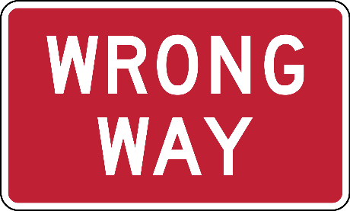
Authority

Slide 14
Authority
Observation of statements
Observation of examples
Drawing necessary conclusions

Slide 15
Mindset of Authority
Be diligent to present yourself approved to God as a workman who does not need to be ashamed, accurately handling the word of truth 2 Timothy 2:15
Mindset
- The intention to please God
- The effort of seeking approval

Slide 16
The Law of Christ
The New Testament is the Covenant of Christ
The Promises – Eternal life
The Law of Christ – the New Testament
How do we understand law (or promises)?
Universally – 2 Peter 1:20
Common interpretive standards – 2 Tim. 1:13

Slide 17
The Law of Christ
The Purpose of the Old Testament
Now these things happened to them as an example, and they were written for our instruction, upon whom the ends of the ages have come. 1 Corinthians 10:11

Slide 18
The Law of Christ
The OT provides the conceptual understanding of Law
God created three ways to collect relevant information
- Commandments/statements
- Approved examples
- Necessary/absolute inferences/conclusion
Notes:
Uzzah and moving the ark

Slide 19
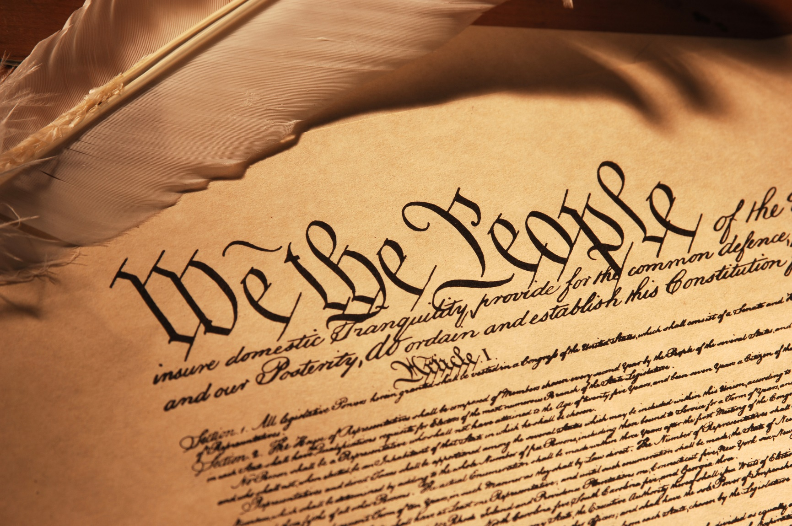
Universal Interpretation
All written rule of law is interpreted this way:
- The written code
- The authority of case law
- Conclusions based on related data

Slide 20
The Methodology of the OT
God expected commandments to be obeyed
- Genesis 26:5, 2 Kings 17:19
God expected approved examples to be followed
- 1 Kings 11:6, 2 Chronicles 17:3
God expected men to draw conclusions
- Genesis 4:4, Matthew 23
Notes:
Ge 26:5 "because Abraham obeyed My voice and kept My charge, My commandments, My statutes, and My laws.“
2Ki 17:19 Also Judah did not keep the commandments of the LORD their God, but walked in the statutes of Israel which they made.
1Ki 11:6 Solomon did evil in the sight of the LORD, and did not fully follow the LORD, as did his father David.
2Ch 17:3 Now the LORD was with Jehoshaphat, because he walked in the former ways of his father David; he did not seek the Baals,
Ge 4:4 Abel also brought of the firstborn of his flock and of their fat. And the LORD respected Abel and his offering,

Slide 21
The Methodology of Jesus
“Keep my commandments”
John 14:15
“I gave you an example that you also should do”
John 13:15
“If you knew…. You ought to have done”
Matthew 25:26-27

Slide 22
The Methodology of Apostles
“If anyone does not obey our instruction in this letter, take special note of that person”
2 Thessalonians 3:14
“In order to offer ourselves as a model for you, so that you would follow our example”
2 Thessalonians 3:9
“It is already a defeat for you, that you have lawsuits”
1 Corinthians 6:7

Slide 23
Removing Personal Interpretation
What seems right in my heart (Proverbs 14:12)
Following the common belief (Matthew 7:13)
What I have always done (Matthew 15:9)
Notes:
Pr 14:12 ¶ There is a way that seems right to a man, But its end is the way of death.
Mt 7:13 "Enter by the narrow gate; for wide is the gate and broad is the way that leads to destruction, and there are many who go in by it.
Mt 15:9 And in vain they worship Me, Teaching as doctrines the commandments of men.'"

Slide 24
Removing Personal Interpretation
What seems right in my heart (Proverbs 14:12)
Following the common belief (Matthew 7:13)
What I have always done (Matthew 15:9)

Slide 25
The Rule of Silence
Now these things, brethren, I have figuratively transferred to myself and Apollos for your sakes, that you may learn in us not to think beyond what is written, that none of you may be puffed up on behalf of one against the other. 1 Corinthians 4:6

Slide 26
The Rule of Silence
Where God has not spoken:
- Consider that He has spoken
- Consider what He has spoken
God’s message in Acts 15
For it seemed good to the Holy Spirit…. Acts 15:28a

Slide 27
The Rule of Silence
Principles of Scriptural interpretation:
The Means To Know God!

Slide 29
Finding Salvation

Slide 30
 | COMMAND | EXAMPLE | INFERENCE

Slide 31
 | COMMAND | EXAMPLE | INFERENCE
HEAR AND BELIEVE
CONFESSION
REPENTANCE
BAPTISM
REMAINING FAITHFUL

Slide 32
 | COMMAND | EXAMPLE | INFERENCE
HEAR AND BELIEVE | Mark 16:16 | Acts 4:4 | Romans 10:10
CONFESSION | Matthew 10:32 | Acts 8:32 | Romans 10:9
REPENTANCE | Acts 2:38 | Acts 8:24 | 1 John 1
BAPTISM | Acts 22:16 | Acts 8:38 | 1 Peter 3:21
REMAINING FAITHFUL | Revelation 2:10 | 2 Timothy 4:7 | Acts 7:59

